Slide 1
EPIDEMIC AND DISEASE MODELLING
BY
ASHISH SANGHVI

Slide 2
EPIDEMIC MODELLING EXPONENTIAL GROWTH
THE MOST BASIC COMPONENT OF A EPIDEMIC MODEL IS THE REPRODUCTIVE NUMBER (R0): WHICH IS THE NUMBER OF SECONDARY INFECTED INDIVIDUALS THAT YOU CAN EXPECT TO HAVE ON AN AVERAGE IN A POPULATION FROM A SINGLE SOURCE OF PRIMARY INFECTION.
IT BASICALLY FORMS THE SEED FOR THE EPIDEMIC.
IF R0 <1 THEN THE DISEASE WILL DIE DOWN IE., EACH PERSON CAN INFECT LESS THAN 1 PERSON THEN DISEASE CANNOT SUSTAIN
IF R0 =1 THEN DISEASE STAYS ALIVE AND STABLE BUT WILL NOT OUTBREAK AS EPIDEMIC
IF R0>1 THEN DISEASE CAN CAUSE AN EPIDEMIC
ITS ALSO OBSERVED THAT DIFFERENT VARIANTS OF COVID HAVE DIFFERENT REPRODUCTIVE NUMBER
R0 FOR DIAMOND PRINCESS CRUISE SHIP WAS AROUND 2.28 IN EARLY FEBRUARY
R0 FOR THE TRIPLE MUTATING STRAIN FOUND IN INDIA IS ABOVE 3.00

Slide 3
SIR- MODEL
S
I
R
THE MODEL HAS 3 COMPONENTS:
S = SUSCEPTIBLE
I = INFECTED
R = REMOVED (RECOVERED OR DIED)
THREE MAJOR ASSUMPTIONS OF THE MODEL:
THE TOTAL POPULATION REMAINS CONSTANT
THE RATE OF INFECTION WHICH IS PROPORTIONAL TO THE CONTACT BETWEEN THE INFECTED AND SUSCEPTIBLES IS A CONSTANT
THE REMOVAL RATE IS CONSTANT IE., THE DEATH AND RECOVERY RATE ARE CONSTANT

Slide 4
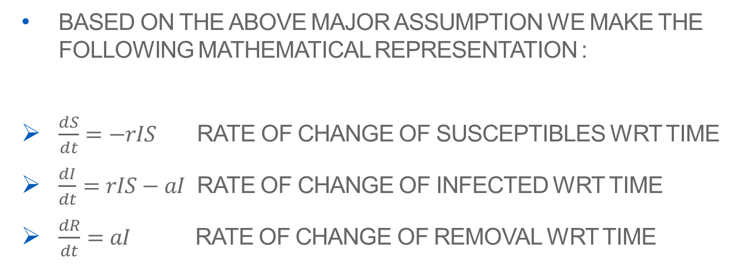
MATHEMATICAL REPRESENTATION:
BASED ON THE ABOVE MAJOR ASSUMPTION WE MAKE THE FOLLOWING MATHEMATICAL REPRESENTATION :
$\frac{ⅆS}{ⅆt}=−rIS$ RATE OF CHANGE OF SUSCEPTIBLES WRT TIME
$\frac{dI}{dt}=rIS−aI$ RATE OF CHANGE OF INFECTED WRT TIME
$\frac{dR}{dt}=aI$ RATE OF CHANGE OF REMOVAL WRT TIME
CONSTANTS USED:
r – RATE OF CONTACT
a – RATE OF REMOVAL (RECOVERED/DYING)
I – NUMBER OF INFECTED INDIVIDUALS
S – NUMBER OF SUSCEPTIBLES

Slide 5
IMPORTANT QUESTIONS:
WILL THE DISEASE SPREAD?
WHAT WILL BE THE NUMBER OF INFECTED?
HOW MANY PEOPLE WILL END UP CATCHING THE DISEASE?

Slide 6
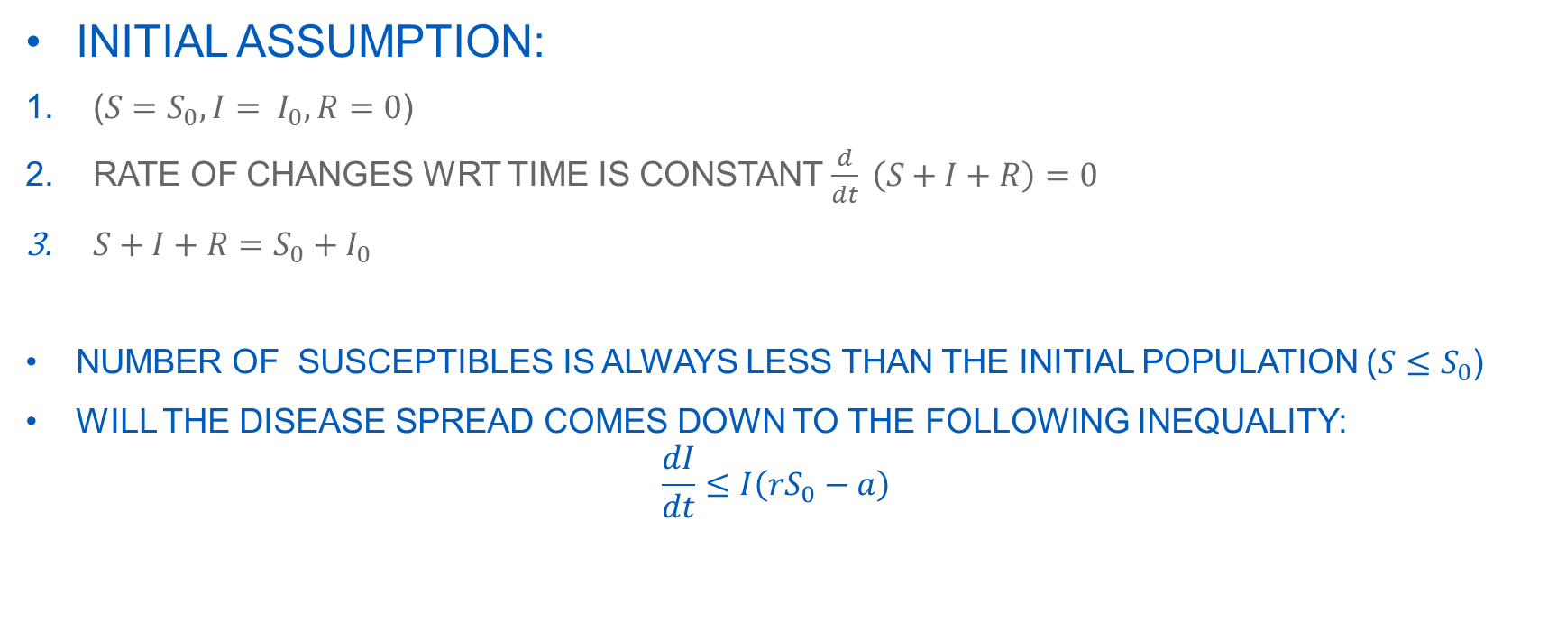
WILL THE DISEASE SPREAD?
INITIAL ASSUMPTION:
($S=S_{0}, I= I_{0}, R=0$)
RATE OF CHANGES WRT TIME IS CONSTANT $\frac{d}{dt} \left(S+I+R\right)=0$
$S+I+R=S_{0}+I_{0}$
NUMBER OF SUSCEPTIBLES IS ALWAYS LESS THAN THE INITIAL POPULATION ($S≤S_{0}$)
WILL THE DISEASE SPREAD COMES DOWN TO THE FOLLOWING INEQUALITY:
$$\frac{dI}{dt}≤I\left(rS_{0}−a\right)$$

Slide 7
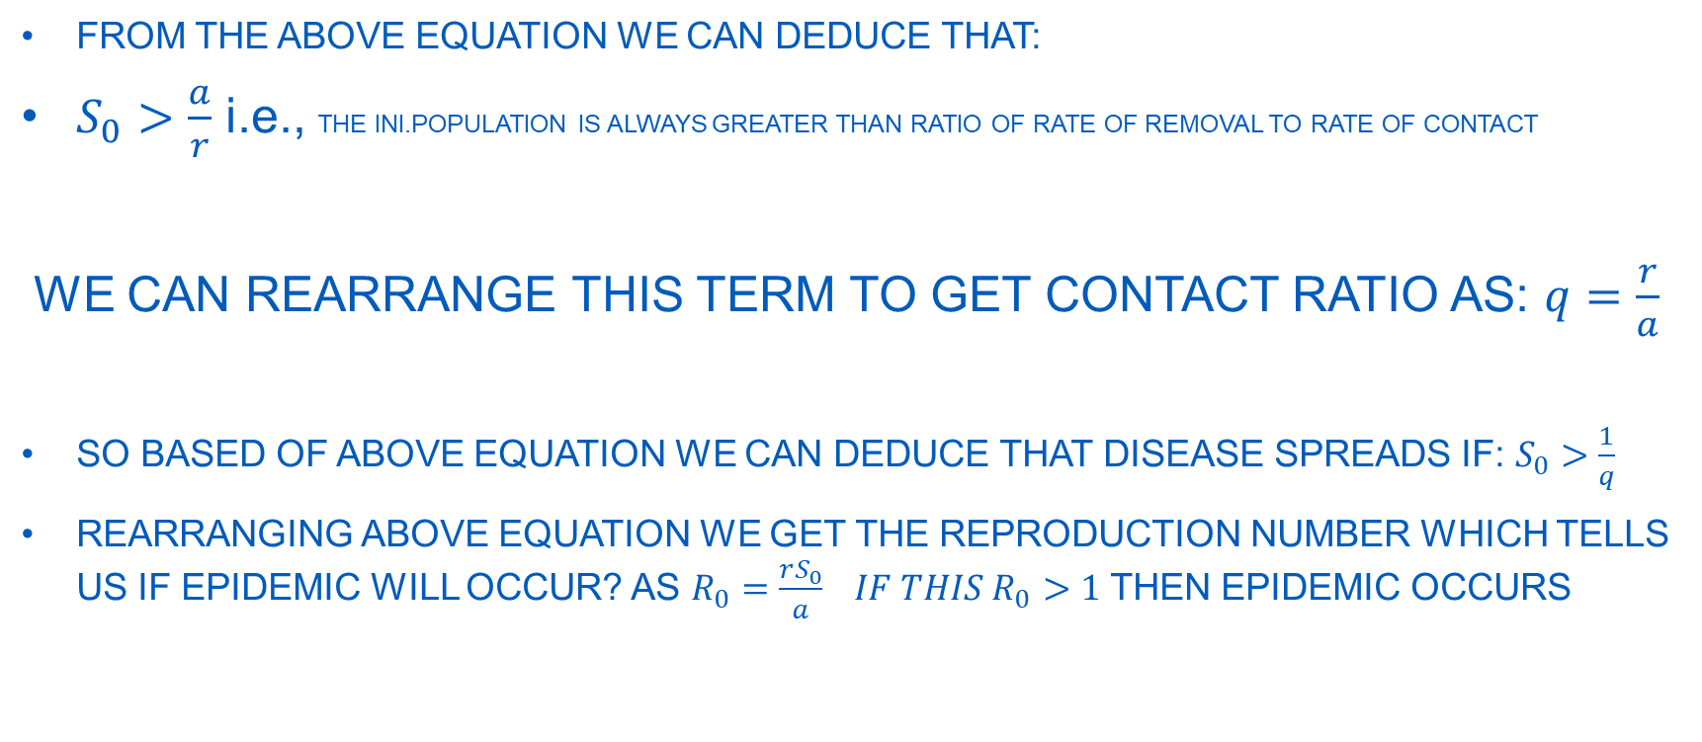
WILL THE DISEASE SPREAD?
FROM THE ABOVE EQUATION WE CAN DEDUCE THAT:
$S_{0}>\frac{a}{r}$ i.e., THE INI.POPULATION IS ALWAYS GREATER THAN RATIO OF RATE OF REMOVAL TO RATE OF CONTACT
WE CAN REARRANGE THIS TERM TO GET CONTACT RATIO AS: $q=\frac{r}{a}$
SO BASED OF ABOVE EQUATION WE CAN DEDUCE THAT DISEASE SPREADS IF: $S_{0}>\frac{1}{q}$
REARRANGING ABOVE EQUATION WE GET THE REPRODUCTION NUMBER WHICH TELLS US IF EPIDEMIC WILL OCCUR? AS $R_{0}=\frac{rS_{0}}{a} IF THIS R_{0}>1$THEN EPIDEMIC OCCURS

Slide 8
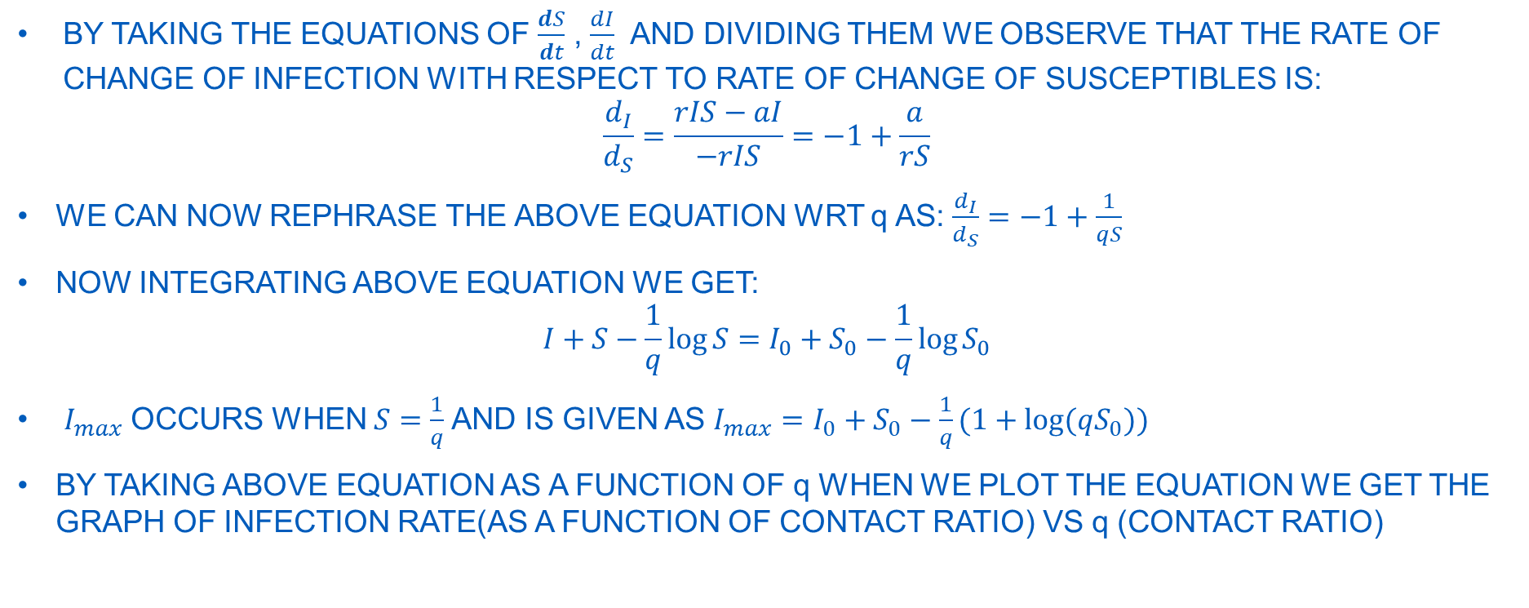
WHAT WILL BE NUMBER OF INFECTED?
BY TAKING THE EQUATIONS OF $\frac{ⅆS}{ⅆt}$ , $\frac{dI}{dt}$ AND DIVIDING THEM WE OBSERVE THAT THE RATE OF CHANGE OF INFECTION WITH RESPECT TO RATE OF CHANGE OF SUSCEPTIBLES IS:
$$\frac{d_{I}}{d_{S}}=\frac{rIS−aI}{−rIS}=−1+\frac{a}{rS}$$
WE CAN NOW REPHRASE THE ABOVE EQUATION WRT q AS: $\frac{d_{I}}{d_{S}}=−1+\frac{1}{qS}$
NOW INTEGRATING ABOVE EQUATION WE GET:
$$I+S−\frac{1}{q}\log{S}=I_{0}+S_{0}−\frac{1}{q}\log{S_{0}}$$
$I_{max}$OCCURS WHEN $S=\frac{1}{q}$AND IS GIVEN AS $I_{max}=I_{0}+S_{0}−\frac{1}{q}(1+\log{(qS_{0})})$
BY TAKING ABOVE EQUATION AS A FUNCTION OF q WHEN WE PLOT THE EQUATION WE GET THE GRAPH OF INFECTION RATE(AS A FUNCTION OF CONTACT RATIO) VS q (CONTACT RATIO)

Slide 9
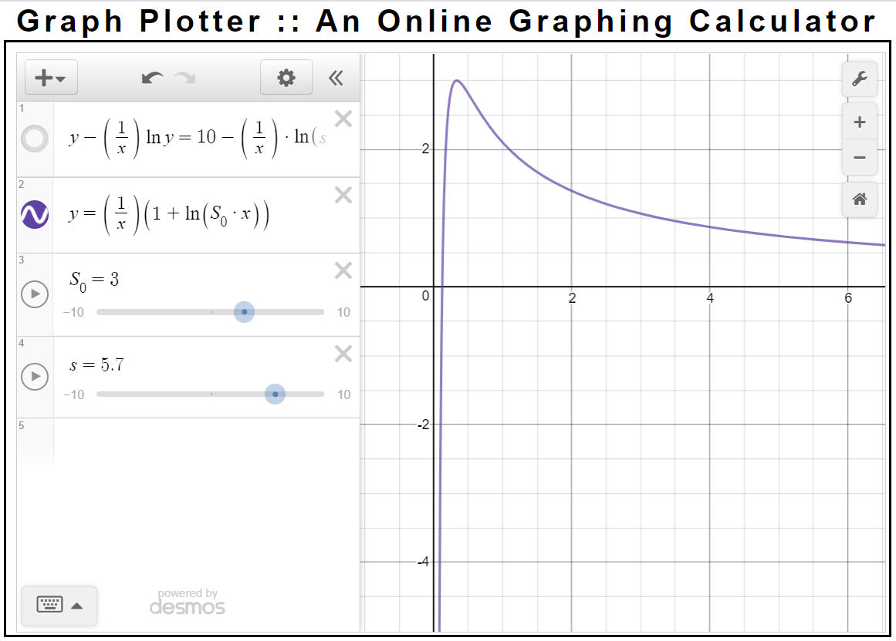
OBSERVATIONS:
FROM THE GIVEN GRAPH ITS OBSERVED THAT AS q INCREASES THE FUNCTION OF q(INFECTION RATE) BECOMES VERY SMALL.. WHICH TELLS US THAT THE
MAXIMUM NUMBER OF PEOPLE THAT CAN HAVE INFECTION AT ANY TIME IS:
TOTAL_POPULATION – f(q)
WHICH IS QUITE BAD FOR A DISEASE WITH LARGE q VALUES AS f(q) IS QUITE SMALL MEANING ALMOST ENTIRE POPULATION IS SUSCEPTIBLE TO INFECTION.

Slide 10
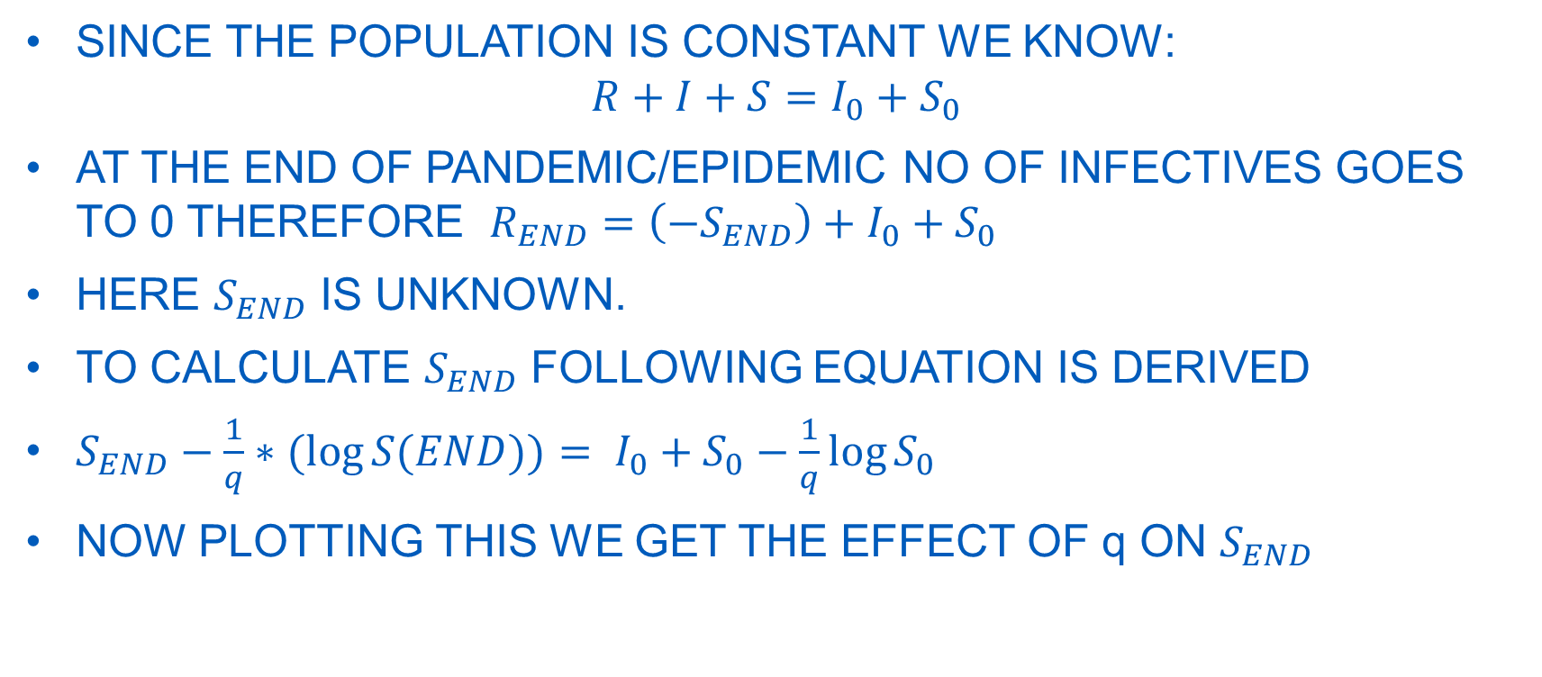
HOW MANY PEOPLE WILL END UP CATCHING THE DISEASE?
SINCE THE POPULATION IS CONSTANT WE KNOW:
$$R+I+S=I_{0}+S_{0}$$
AT THE END OF PANDEMIC/EPIDEMIC NO OF INFECTIVES GOES TO 0 THEREFORE $R_{END}=\left(−S_{END}\right)+I_{0}+S_{0}$
HERE $S_{END}$ IS UNKNOWN.
TO CALCULATE $S_{END}$ FOLLOWING EQUATION IS DERIVED
$S_{END}−\frac{1}{q}∗(log{S(END))= I_{0}+S_{0}−\frac{1}{q}\log{S_{0}}}$
NOW PLOTTING THIS WE GET THE EFFECT OF q ON $S_{END}$

Slide 11
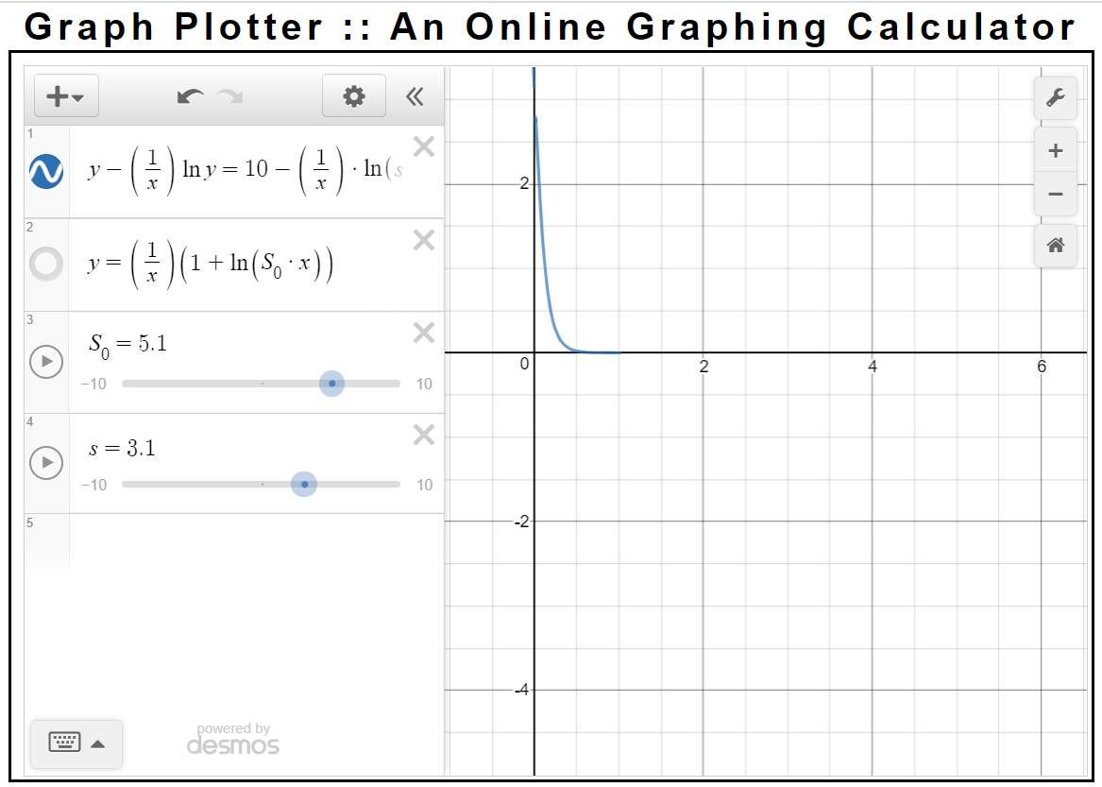
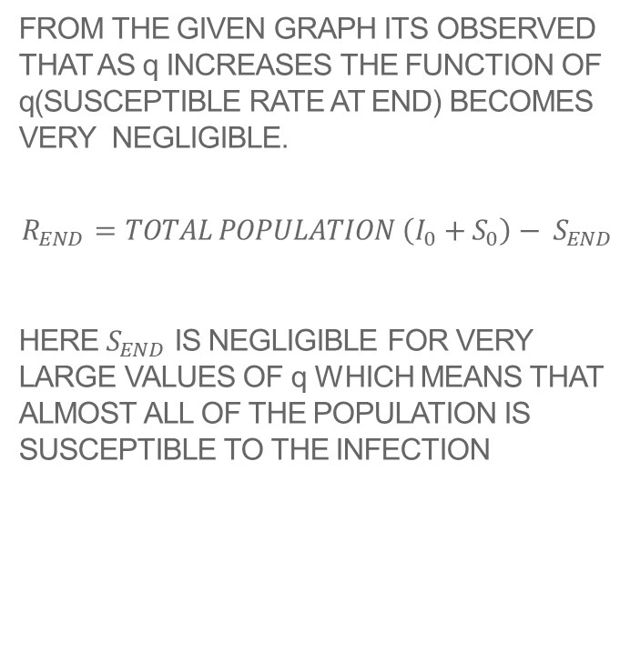
OBSERVATIONS:
FROM THE GIVEN GRAPH ITS OBSERVED THAT AS q INCREASES THE FUNCTION OF q(SUSCEPTIBLE RATE AT END) BECOMES VERY NEGLIGIBLE.
$$R_{END}=TOTAL POPULATION \left(I_{0}+S_{0}\right)− S_{END}$$
HERE $S_{END}$ IS NEGLIGIBLE FOR VERY LARGE VALUES OF q WHICH MEANS THAT ALMOST ALL OF THE POPULATION IS SUSCEPTIBLE TO THE INFECTION

Slide 12
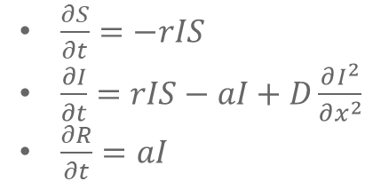
TRAVELLING WAVES
UNTIL NOW WE HAD TAKEN THE ASSUMPTION OF A CONSTANT MOVEMENT NOW HERE WE MAKE AN ASSUMPTION THAT ONLY THE INFECTED MOVE.
BASIC ASSUMPTIONS:
SUSCEPTIBLES DO NOT MOVE
INFECTED PERSONS MIGRATE AT A CONSTANT RATE
REMOVED DO NOT MOVE
$\frac{∂S}{∂t}=−rIS$
$\frac{∂I}{∂t}=rIS−aI+D\frac{∂I^{2}}{∂x^{2}}$
$\frac{∂R}{∂t}=aI$

Slide 13
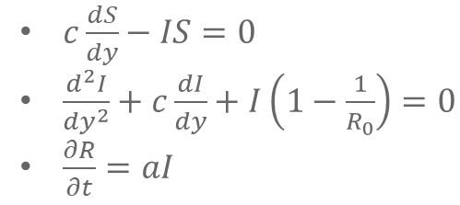
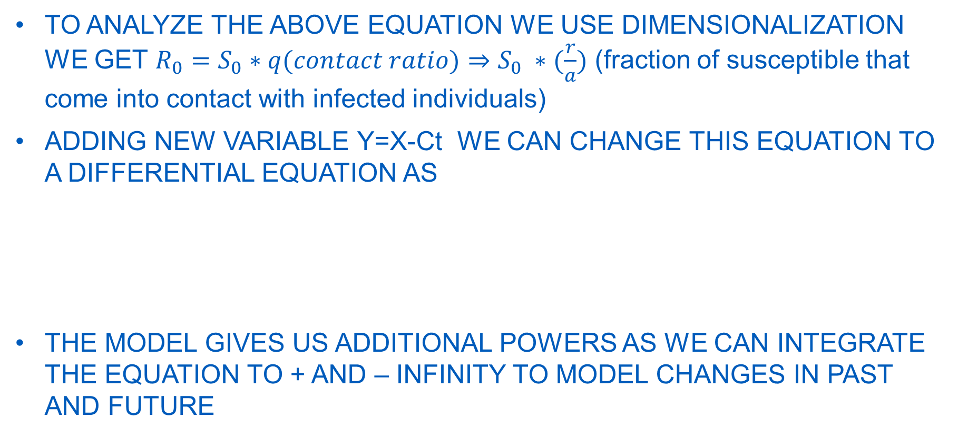
TRAVELLING WAVES
TO ANALYZE THE ABOVE EQUATION WE USE DIMENSIONALIZATION WE GET $R_{0}=S_{0}∗q(contact ratio)⇒S_{0} ∗(\frac{r}{a})$ (fraction of susceptible that come into contact with infected individuals)
ADDING NEW VARIABLE Y=X-Ct WE CAN CHANGE THIS EQUATION TO A DIFFERENTIAL EQUATION AS
THE MODEL GIVES US ADDITIONAL POWERS AS WE CAN INTEGRATE THE EQUATION TO + AND – INFINITY TO MODEL CHANGES IN PAST AND FUTURE
$c\frac{dS}{dy}−IS=0$
$\frac{d^{2}I}{dy^{2}}+c\frac{dI}{dy}+I\left(1−\frac{1}{R_{0}}\right)=0$
$\frac{∂R}{∂t}=aI$

Slide 14
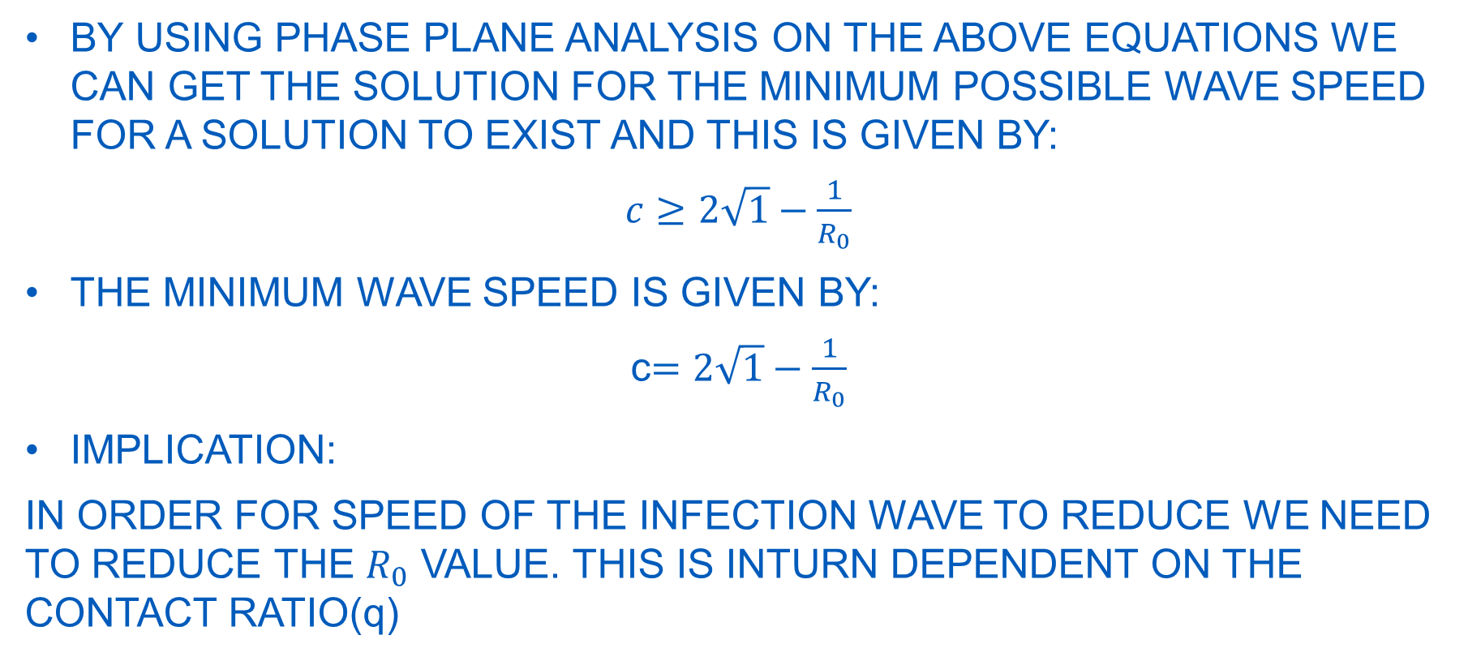
TRAVELLING WAVES
BY USING PHASE PLANE ANALYSIS ON THE ABOVE EQUATIONS WE CAN GET THE SOLUTION FOR THE MINIMUM POSSIBLE WAVE SPEED FOR A SOLUTION TO EXIST AND THIS IS GIVEN BY:
$c≥2\sqrt{1}−\frac{1}{R_{0}}$
THE MINIMUM WAVE SPEED IS GIVEN BY:
c$=2\sqrt{1}−\frac{1}{R_{0}}$
IMPLICATION:
IN ORDER FOR SPEED OF THE INFECTION WAVE TO REDUCE WE NEED TO REDUCE THE $R_{0}$ VALUE. THIS IS INTURN DEPENDENT ON THE CONTACT RATIO(q)

Slide 15
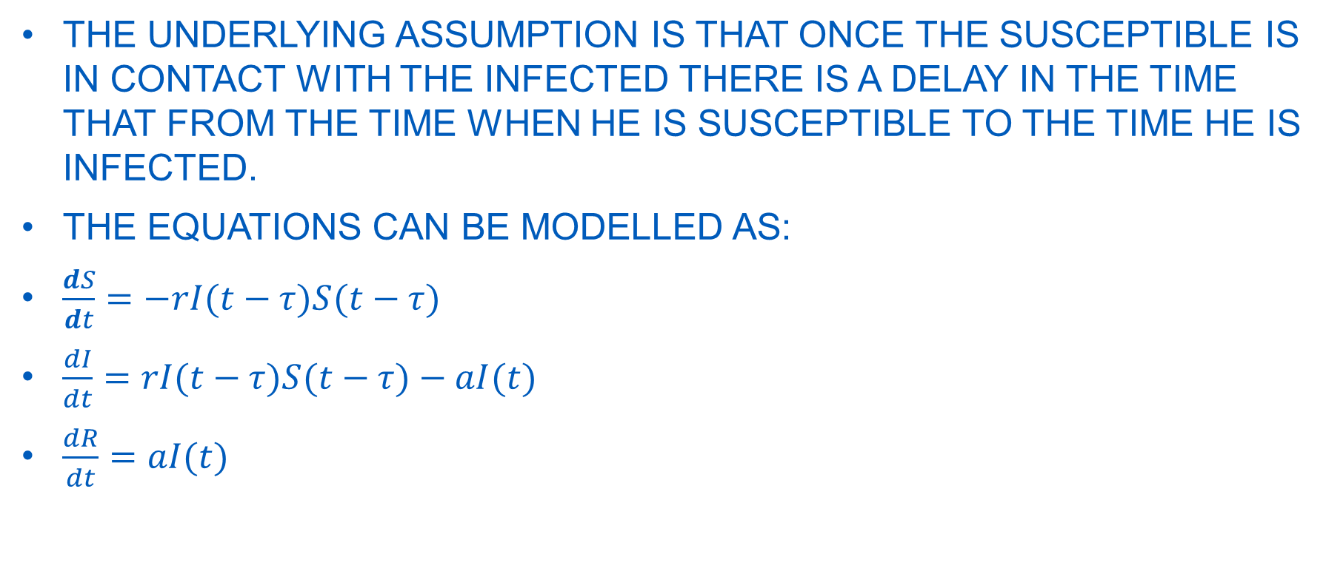
INCUBATION PERIOD
THE UNDERLYING ASSUMPTION IS THAT ONCE THE SUSCEPTIBLE IS IN CONTACT WITH THE INFECTED THERE IS A DELAY IN THE TIME THAT FROM THE TIME WHEN HE IS SUSCEPTIBLE TO THE TIME HE IS INFECTED.
THE EQUATIONS CAN BE MODELLED AS:
$\frac{ⅆS}{ⅆt}=−rI(t−τ)S(t−τ)$
$\frac{dI}{dt}=rI(t−τ)S(t−τ)−aI(t)$
$\frac{dR}{dt}=aI(t)$

Slide 16
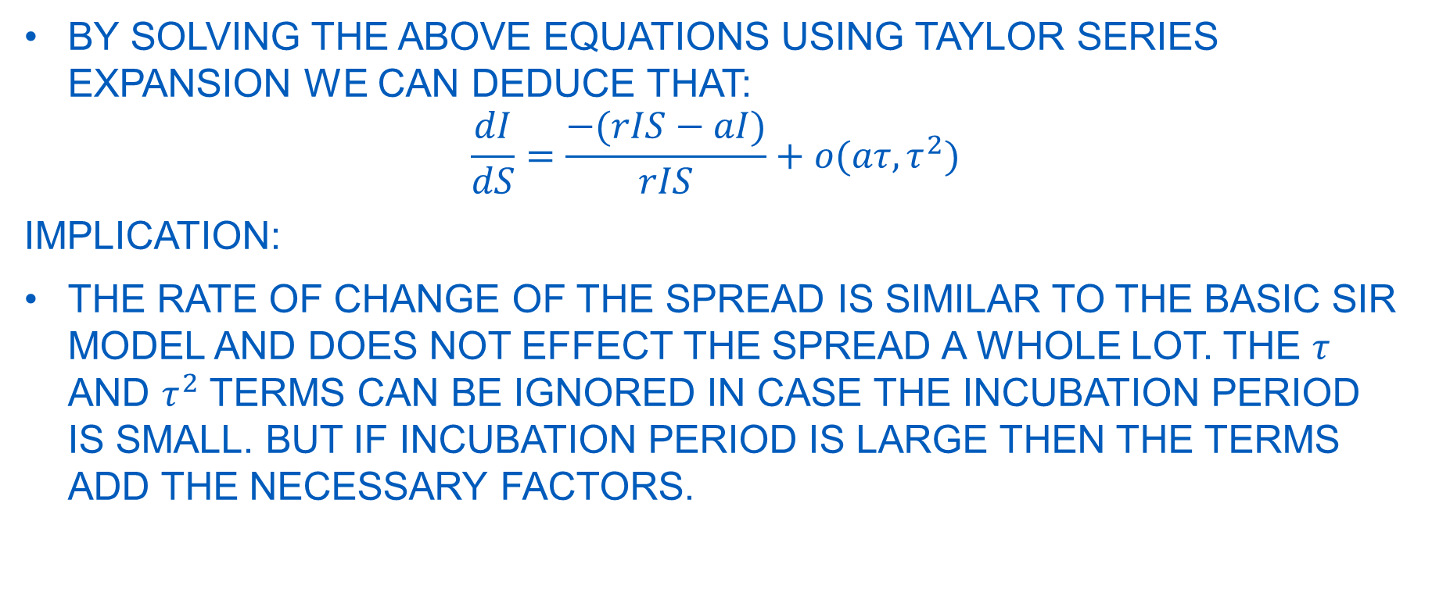
INCUBATION PERIOD
BY SOLVING THE ABOVE EQUATIONS USING TAYLOR SERIES EXPANSION WE CAN DEDUCE THAT:
$$\frac{dI}{dS}=\frac{−(rIS−aI)}{rIS}+o(aτ,τ^{2})$$
IMPLICATION:
THE RATE OF CHANGE OF THE SPREAD IS SIMILAR TO THE BASIC SIR MODEL AND DOES NOT EFFECT THE SPREAD A WHOLE LOT. THE $τ$ AND $τ^{2}$ TERMS CAN BE IGNORED IN CASE THE INCUBATION PERIOD IS SMALL. BUT IF INCUBATION PERIOD IS LARGE THEN THE TERMS ADD THE NECESSARY FACTORS.

Slide 17
VACCINATION
WE CAN STUDY THE EFFECT OF VACCINATION ON THE DISEASE SPREAD THROUGH TWO MAIN QUESTIONS:
CONDITION FOR DISEASE TO STOP AND HOW MANY PEOPLE DO WE NEED TO VACCINATE?
WHAT HAPPENS IF THE VACCINE IS NOT 100 PERCENT EFFECTIVE?

Slide 18
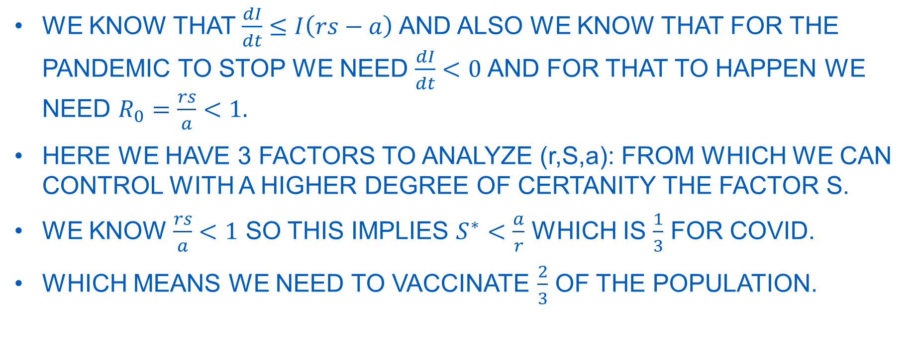
CONDITION FOR DISEASE TO STOP AND HOW MANY PEOPLE DO WE NEED TO VACCINATE?
WE KNOW THAT $\frac{dI}{dt}≤I\left(rs−a\right)$AND ALSO WE KNOW THAT FOR THE PANDEMIC TO STOP WE NEED $\frac{dI}{dt}<0$ AND FOR THAT TO HAPPEN WE NEED $R_{0}=\frac{rs}{a}<1.$
HERE WE HAVE 3 FACTORS TO ANALYZE (r,S,a): FROM WHICH WE CAN CONTROL WITH A HIGHER DEGREE OF CERTANITY THE FACTOR S.
WE KNOW $\frac{rs}{a}<1$ SO THIS IMPLIES $S^{∗}<\frac{a}{r}$ WHICH IS $\frac{1}{3}$ FOR COVID.
WHICH MEANS WE NEED TO VACCINATE $\frac{2}{3}$ OF THE POPULATION.

Slide 19
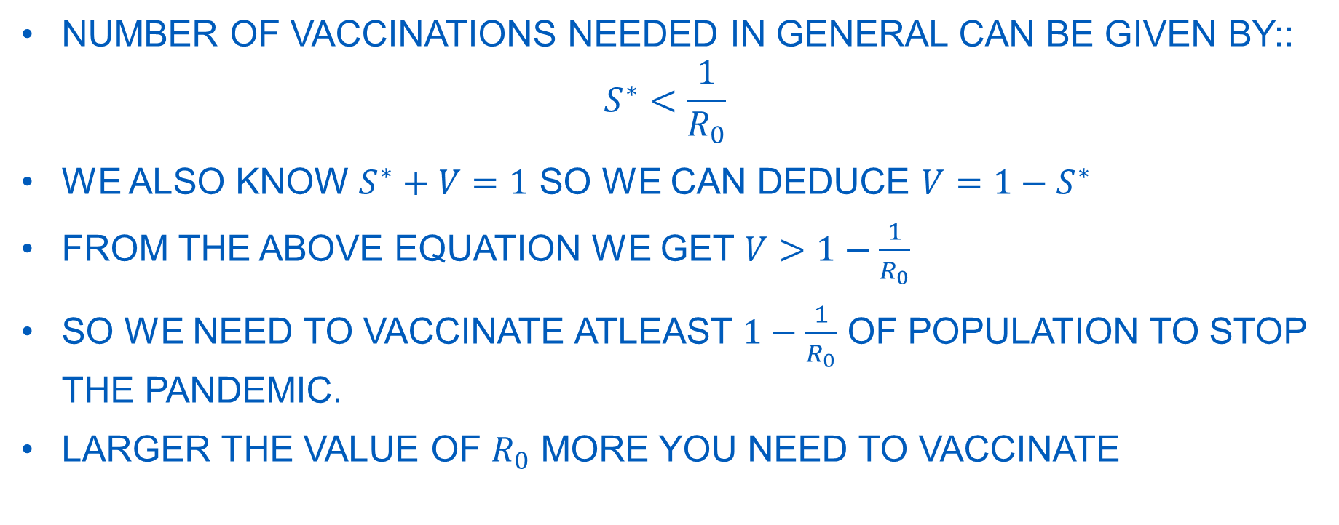
HOW MANY VACCINES ARE NEEDED IN GENERAL?
NUMBER OF VACCINATIONS NEEDED IN GENERAL CAN BE GIVEN BY::
$$S^{∗}<\frac{1}{R_{0}}$$
WE ALSO KNOW $S^{∗}+V=1$ SO WE CAN DEDUCE $V=1−S^{∗}$
FROM THE ABOVE EQUATION WE GET $V>1−\frac{1}{R_{0}}$
SO WE NEED TO VACCINATE ATLEAST $1−\frac{1}{R_{0}}$ OF POPULATION TO STOP THE PANDEMIC.
LARGER THE VALUE OF $R_{0}$ MORE YOU NEED TO VACCINATE

Slide 20
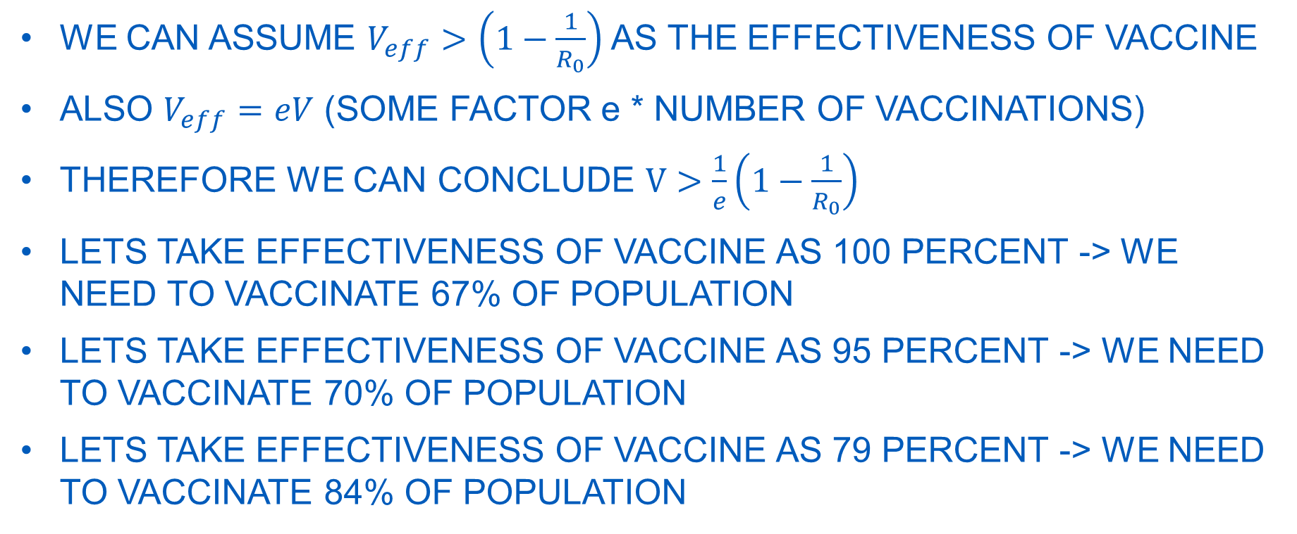
WHAT HAPPENS IF VACCINES ARE NOT 100% EFFECTIVE?
WE CAN ASSUME $V_{eff}>\left(1−\frac{1}{R_{0}}\right)$ AS THE EFFECTIVENESS OF VACCINE
ALSO $V_{eff}=eV$ (SOME FACTOR e * NUMBER OF VACCINATIONS)
THEREFORE WE CAN CONCLUDE $V>\frac{1}{e}\left(1−\frac{1}{R_{0}}\right)$
LETS TAKE EFFECTIVENESS OF VACCINE AS 100 PERCENT -> WE NEED TO VACCINATE 67% OF POPULATION
LETS TAKE EFFECTIVENESS OF VACCINE AS 95 PERCENT -> WE NEED TO VACCINATE 70% OF POPULATION
LETS TAKE EFFECTIVENESS OF VACCINE AS 79 PERCENT -> WE NEED TO VACCINATE 84% OF POPULATION

Slide 21
THE END
THANK YOU SO MUCH…..
PROFESSOR JOHANNES HACHMANN
MISS KAELEIGH PERI
PROFESSOR GARY DARGUSH
PROFESSOR DAVID SALAC
PROFESSOR EHSAN TARKESH ESFAHANI
PROFESSOR MOHAMMED KHAWAR ZIA
PROFESSOR DIETRICH KUHLMANN

